Slide 1
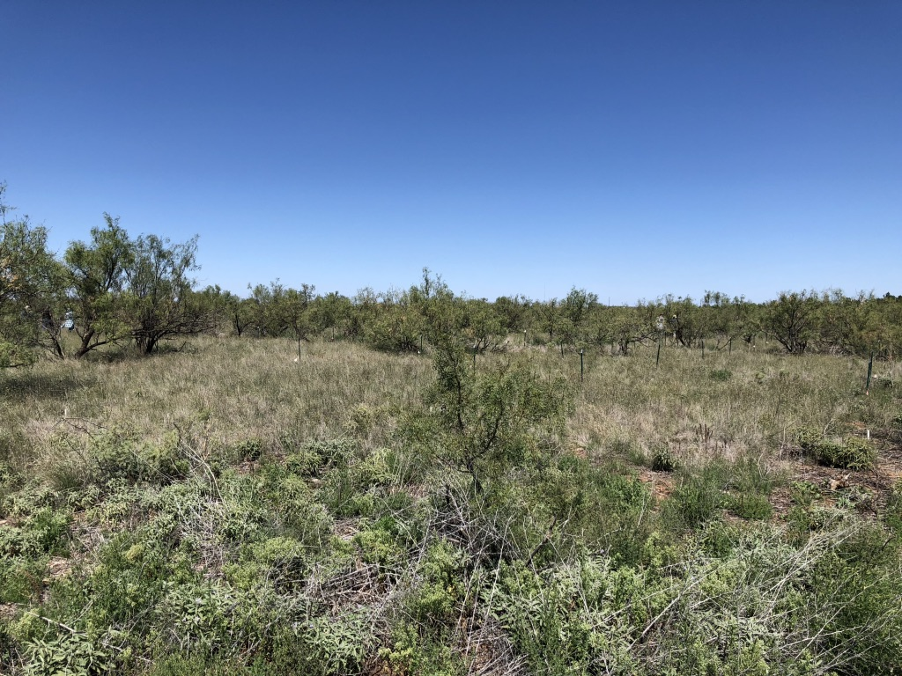
The effect of soil nutrient fertilization on leaf economics: a least-cost perspective
Nick Smith & many others

Slide 2
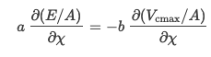
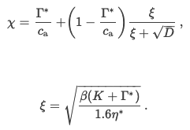
Soil nitrogen should modify the costs to obtain nitrogen (β) and, thus, χ
a = cost to maintain transpiration
b = cost to maintain photosynthetic capacity
β = b/a
ξ = “squiggle”

Slide 3
Soil nitrogen
VPD
T
β
χ
Soil water

Slide 4
Nfix
C4
Soil nitrogen
VPD
T
β may differ for different plant types
β
χ
Soil water

Slide 5
Nfix
C4
Soil nitrogen
VPD
T
β may differ with different nutrient allocation responses
Biomass
β
χ
Soil water

Slide 6
Nfix
C4
Soil nitrogen
VPD
T
Literature support for some arrows, but not others
Biomass
β
χ
Soil water

Slide 7
Dataset
Nutrient Network (NPK full factorial)
Leaf δ13C
2011 individual leaves
26 sites
167 C4 individuals
227 Nfixers

Slide 8
Nfix
C4
Soil nitrogen
VPD
T
Biomass
β
χ
Soil nitrogen and photosynthetic pathway are the only significant drivers of β and χ
Soil water

Slide 9
-8%
-79%
-1%
-22%

Slide 10
Extending to least cost model for prediction
Least cost model
C3: Prentice et al., 2014
C4: Scott and Smith, 2022
Simulations
Average β to simulate χ
β from low and high N to simulate χ

Slide 11
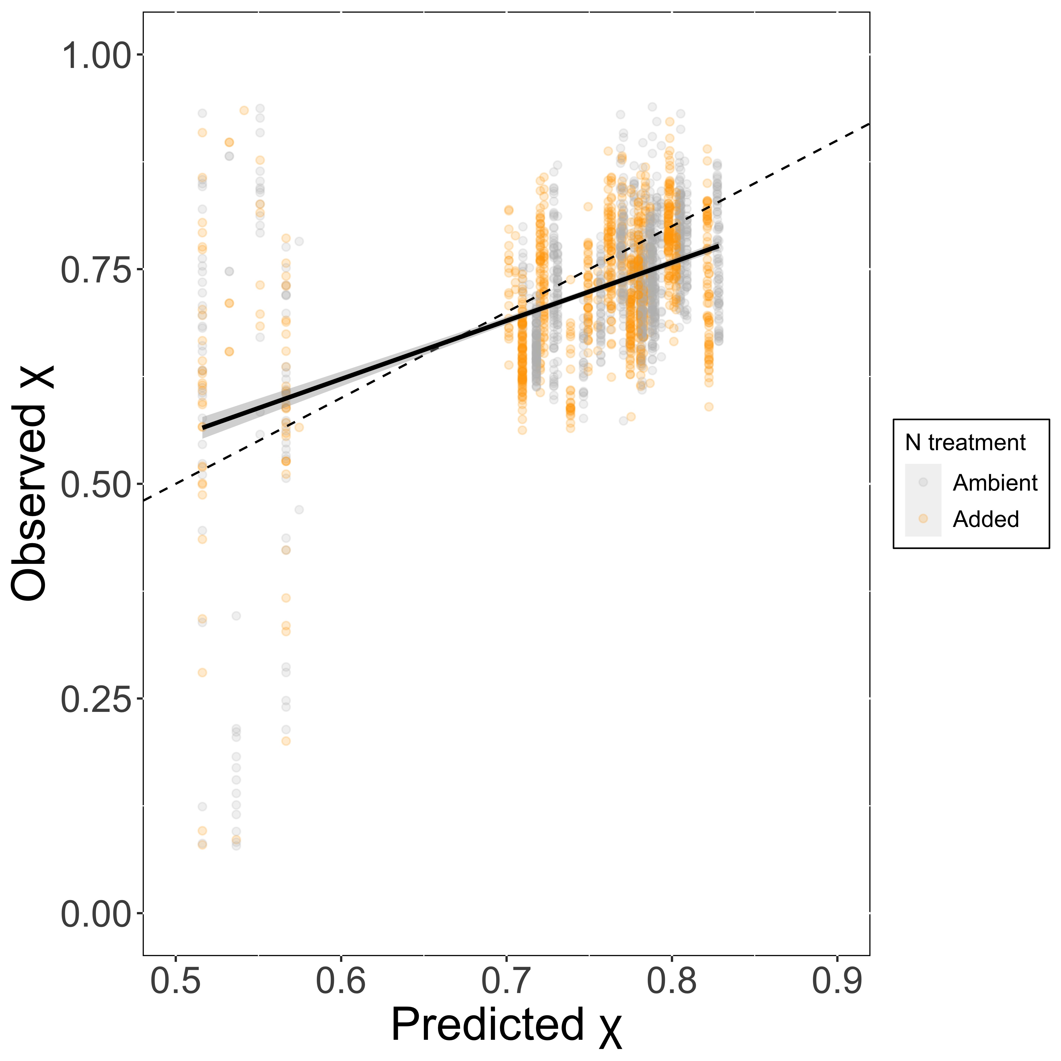
R2 = 0.24
slope = 0.68
Obvious C3/C4 differences
Similar regardless of whether β is adjusted for soil N

Slide 12
Next steps
Coupled leaf chemistry and gas exchange from across the network
Jeff Chieppa

Slide 13
Question for group: where would you like to see this analysis and measurement campaign go?

Slide 14
SEM
Nfix
C4
Soil nitrogen
VPD
T
β
χ
Soil water

Slide 15
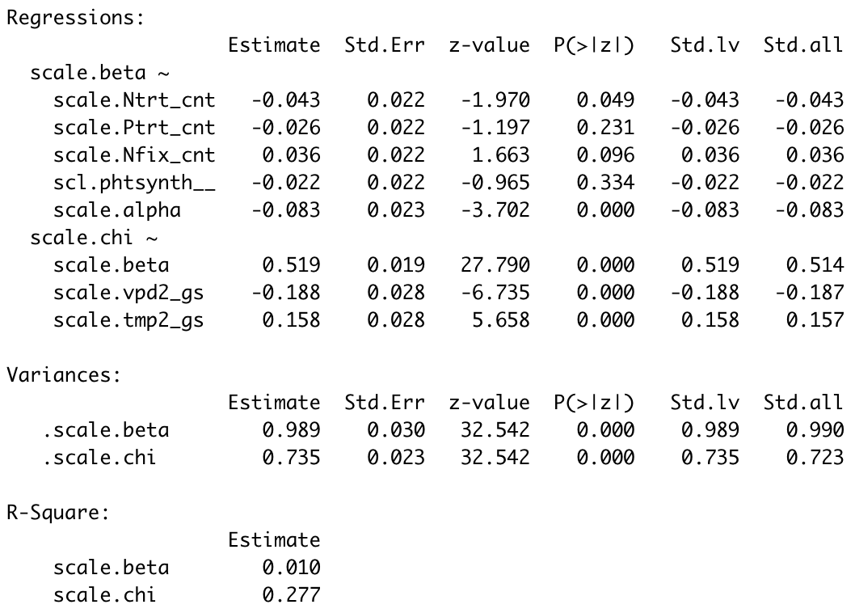
SEM
Nfix
C4
Soil nitrogen
VPD
T
β
χ
Soil water

Slide 16
Extra slides

Slide 17
Nfix
C4
Soil nitrogen
Question 1: what drives variation in β?
β
Soil water

Slide 18
Nfix
C4
Soil nitrogen
β ~ N + moisture + Nfix + C4 +
(1|species) + (1|site) + (1|block:site) + (1|block:site :PK)
β
Soil water

Slide 19
Nfix
C4
Soil nitrogen
β
Soil water
8% decrease with added N
79% decrease in C4

Slide 20
Nfix
C4
Soil nitrogen
Question 2: does biomass influence β response?
Biomass
β
Soil water

Slide 21
Nfix
C4
Soil nitrogen
β ~ N*AGB + moisture*AGB +
Nfix + C4 +
(1|species) + (1|site) + (1|block:site) + (1|block:site :PK)
Biomass
β
Soil water

Slide 22
Nfix
C4
Soil nitrogen
Biomass
β
Soil water
Nothing changes

Slide 23
Nfix
C4
Soil nitrogen
VPD
T
Question 3: can we take what we’ve learned to predict χ?
Biomass
β
χ
Soil water

Slide 24
Nfix
C4
Soil nitrogen
VPD
T
χ ~ N*P*K + moisture +
Nfix + C4 + VPD + T +(1|species) + (1|site) + (1|block:site) + (1|block:site :PK)
Biomass
β
χ
Soil water

Slide 25
Nfix
C4
Soil nitrogen
VPD
T
Biomass
β
χ
Soil water
New direct arrow from soil water to χ

